Slide 1
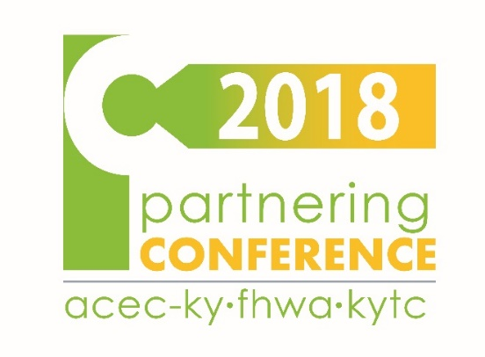
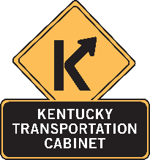
Every Day Counts – Project Development Innovations
2018 Partnering Conference
September 5, 2018
Jason J. Siwula, PE
Executive Director – Office of Highway Safety
Assistant State Highway Engineer - Innovation
Kentucky Transportation Cabinet

Slide 3
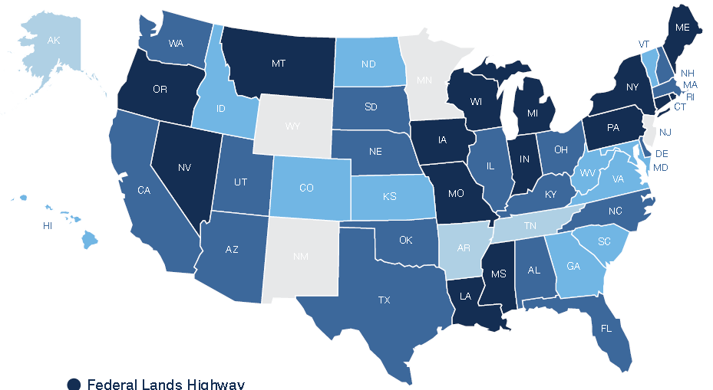
What is “Every Day Counts”?
State-based model to identify and rapidly deploy proven innovations
Notes:
EDC is a stakeholder-based model to identify and rapidly deploy proven, but underutilized innovations.
In developing the EDC initiative, the FHWA recognized that State DOTs serve as innovation leaders for their States and, by partnering with local agencies and industry stakeholders, they play a pivotal role in innovation deployment.
As such, EDC is a stakeholder-based model whereby States select the innovations which best fit the unique needs of the highway community with the State and then work to quickly put those innovations into practice.

Slide 4
Why “Every Day Counts”?
Changing conditions and demand for more efficient project delivery
Technology deployment and transfer are core FHWA roles
Provide a mechanism for rapid deployment of proven innovation
Create a sense of urgency
Notes:
These changes and the challenges each pose require that the highway community look for better ways of doing business to stretch our transportation dollars and improve efficiency to deliver highway projects faster.
To keep pace with the changing times, we wanted to get innovations into practice that would: Shorten the project delivery process; Enhance safety; Reduce congestion; and Improve environmental sustainability.
Leadership in technology transfer and innovation deployment has been a fixture of the FHWA since its origination in 1893 as the Office of Road Inquiry.
Although the highway community has a long history of conducting research to find better solutions and processes, we also have a history of being slow to change and sticking with the way we have always done things.
To build on our legacy of technology transfer and create a sense of urgency, the FHWA launched the Every Day Counts (EDC) initiative in cooperation with AASHTO to do just that.
The name “Every Day Counts” was chosen to capture the driving public’s urgent need for transportation facilities delivered better, faster and smarter.

Slide 5
Every Day Counts
Not about inventing the next “big thing”
Advancing effective, proven and market-ready technologies into widespread use
Other Research Products
Other Proven Innovations
Notes:
EDC is not about inventing the next "big thing".
It's about taking effective, proven and market-ready technologies and getting them into widespread use. These innovations could come from SHRP2, the AASHTO Innovation Initiative, or other sources.
As an EDC innovation more emphasis and resources are provided to get them into every day use.
Proven innovations and enhanced business processes promoted through EDC facilitate greater efficiency at the state and local levels, saving time and resources that can be used to deliver more projects for the same money. Better-Faster-Smarter.

Slide 6
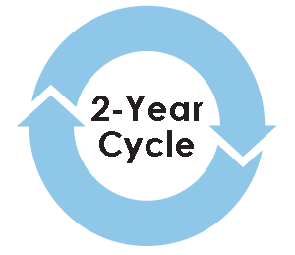
How EDC Works
Stakeholder collaboration to identify and
select innovations
Multidisciplinary deployment team preparation
Draft implementation plans
Compile resources
Assemble case studies
Prepare training
Notes:
Through the EDC model, FHWA works with state and local transportation agencies and industry stakeholders to identify a new collection of a dozen or so innovations to champion every two years.
Innovations are selected collaboratively by stakeholders, taking into consideration market readiness, impacts, benefits and ease of adoption of the innovation.
After selecting the EDC technologies for deployment, FHWA assembles multi-disciplinary technical teams to lead deployment efforts. The deployment teams work to draft implementation plans, compile resources, assemble case studies, and prepare training to educate stakeholders on the selected innovations and ultimately assist in implementation and adoption of the selected innovations.

Slide 7
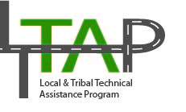

Slide 8
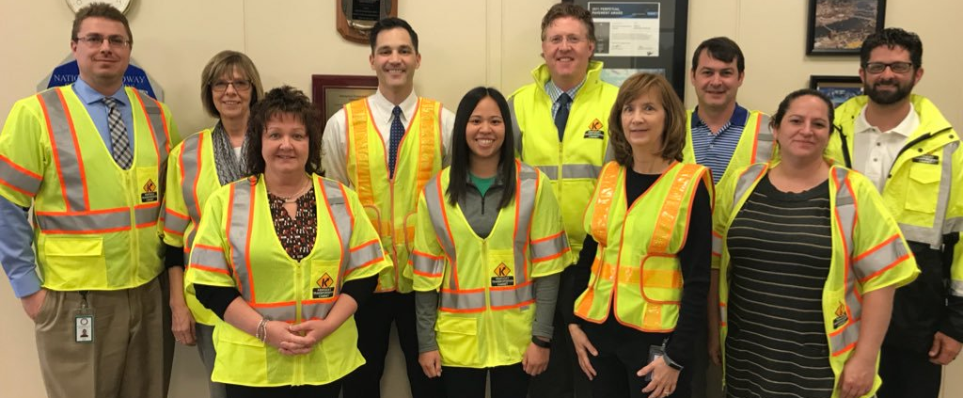
Innovation is a Team Effort!

Slide 9
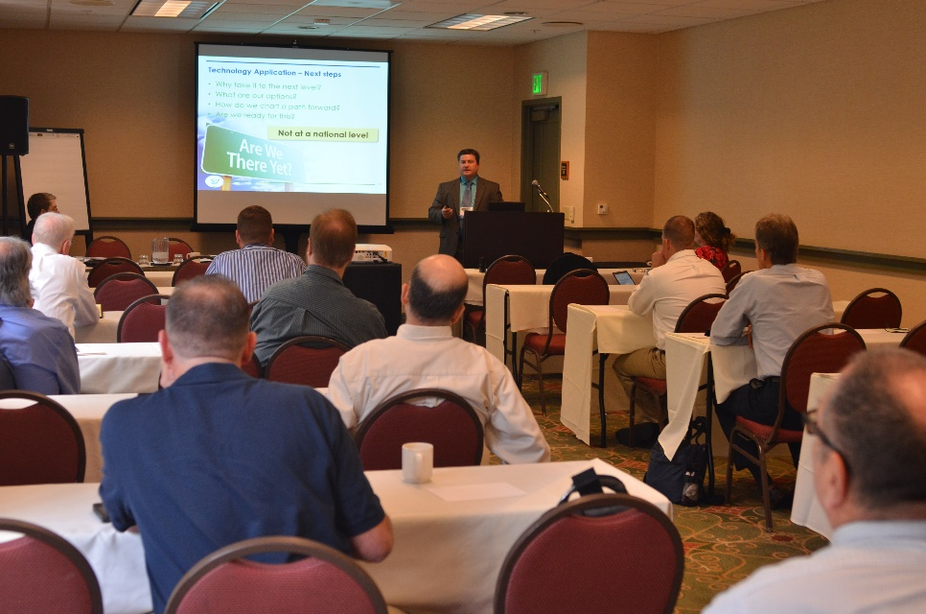
How EDC Works: Summits
Conduct regional summits for transportation stakeholders to:
Learn about selected innovations
Share best practices among neighboring states
Provide feedback on implementation strategies and resource needs
Notes:
After the deployment teams are established and have developed initial implementation plans and resources, transportation leaders from across the country gather at regional summits to discuss the selected innovations and share best practices. Stakeholders attending the summit also provide feedback to the FHWA deployment teams on the proposed implementation strategies and resources agencies will need to adopt or deploy each innovation.
These summits begin the process for states, local public agencies and Federal Lands Highway Divisions to focus on the innovations that make the most sense for their unique program needs, establish performance goals and commit to finding opportunities to get those innovations into practice over the next two years.

Slide 10
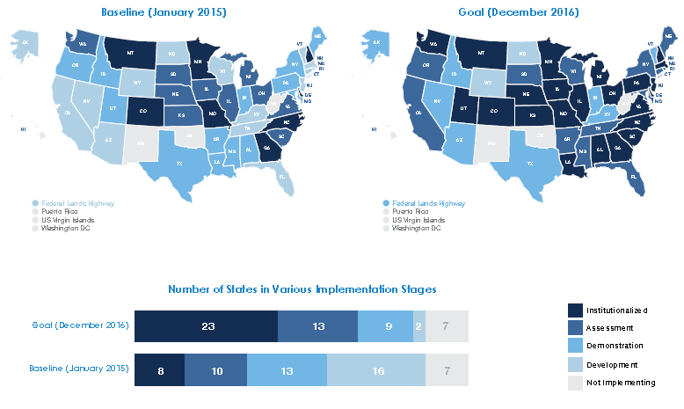
How EDC Works: Setting Goals
States select innovations for deployment and establish goals for level of implementation
Notes:
After learning about the innovations and reviewing them in State caucuses at the summits, participants take their recommendations back to their States for further discussion and development of plans for implementation over the next two years.
In general, State Transportation Innovation Councils (STICs) evaluate and choose innovations that fit the state’s needs and oversee deployment efforts in the state. The STIC concept is about establishing a group of representatives from various levels of the highway community in each State to comprehensively and strategically consider all sources of innovation and to spearhead deployment efforts. The STIC model puts the State in the driver’s seat to select the innovations that best fit the State’s unique needs and approaches and then get those innovations into practice quickly.
To start the process of tracking progress on innovation deployment, FHWA’s EDC coordinators in each State gather information on the current stage of implementation for each innovation at the beginning of EDC cycle and the implementation stage goal the State plans to achieve by the time the two-year cycle ends.
Every six months, FHWA will update the status of the state of practice on the innovations.

Slide 11
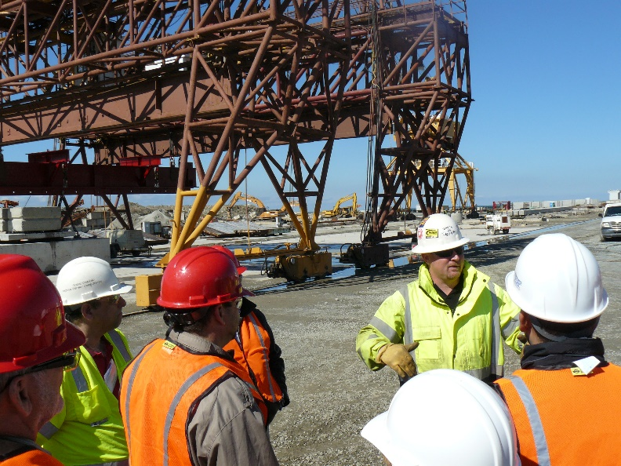
How EDC Works: Deployment
Multidisciplinary deployment teams:
Finalize implementation plans
Provide technical assistance and support:
Training
Webinars and workshops
Demonstrations and peer exchanges
Case studies
Guidance and specifications
Notes:
Throughout the two-year deployment cycle, deployment teams provide technical assistance to help transportation stakeholders deploy the selected innovations.
The assistance includes training sessions, briefings, webinars, workshops, and peer exchanges that enable stakeholders to become knowledgeable about the innovations.
The technical teams also develop guidance documents, specifications where applicable, and coordinate events to demonstrate the innovations on actual projects for stakeholders to observe and learn from the success and challenges of others’ implementation efforts.
Additionally, the FHWA tracks and reports on the national state of practice of each innovation and the successes achieved by States and local public agencies.

Slide 12
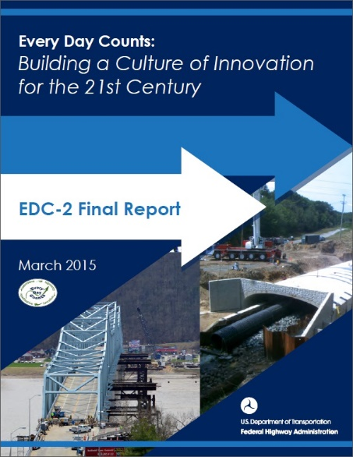
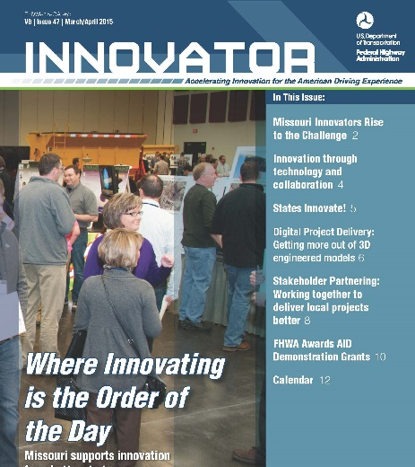
How EDC Works: Reporting
FHWA monitors and reports on state-of-the-practice and successes in accelerating deployment of selected innovations:
Website
EDC News (weekly e-newsletter)
Innovator (bi-monthly e-newsletter)
Progress reports
Articles
Videos
Notes:
Many communication mechanisms are used to promote the selected innovations, report on state-of-the-practice, and share successes achieved by State and local agencies in accelerating the deployment of innovation.

Slide 13
How EDC Works: Incentives
Funding incentive programs:
State Transportation Innovation Council (STIC) Incentive Program
Up to $100,000 available to each STIC per year
Fund activities that have a statewide impact on making an innovation a standard practice
Accelerated Innovation Deployment (AID) Demonstration Program
Incentive funding (up to a maximum of $1,000,000) to offset risk of using an innovation on a project
Notes:
To help STICs institutional innovations within their State, FHWA launched the STIC Incentive Program in September 2013.
The STIC Incentive Program offers technical assistance and funds—up to $100,000 per STIC per year—to support the costs of standardizing innovative practices in a state transportation agency or other public sector STIC stakeholder.
Example activities may include developing standards and specifications, preparing standard operating procedures (SOPs) or technical guidance, developing training, etc.
To be eligible, the State must have a formal STIC with a charter.
The AID Demonstration Program was announced in a Notice of Funding Availability (NOFA) published in the Federal Register on February 19, 2014.
The AID Demonstration Program provides incentive funding to offset risk of using an innovation on a project. The funding award is for the full cost of the innovation on a project, up to $1 million.

Slide 14
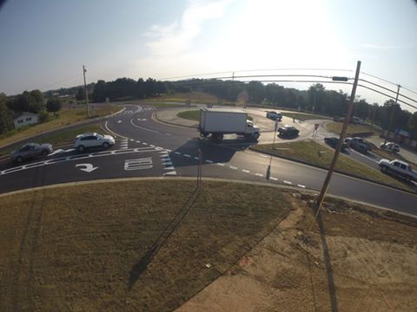
CASE STUDY – Laurel County Roundabout
Accelerated Innovation Deployment Demonstration Grant for $1,000,000 from FHWA (approximately $3,000,000 total cost)
Opened to traffic in August 2015

Slide 15
AID Demo - Pre-existing Condition

Slide 16
AID Demo - Challenge

Slide 17
AID Demo -Solution

Slide 18
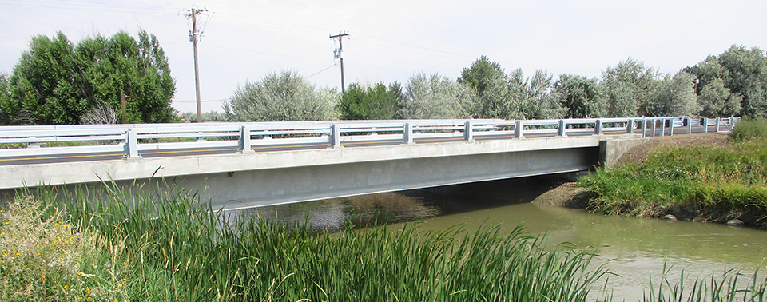
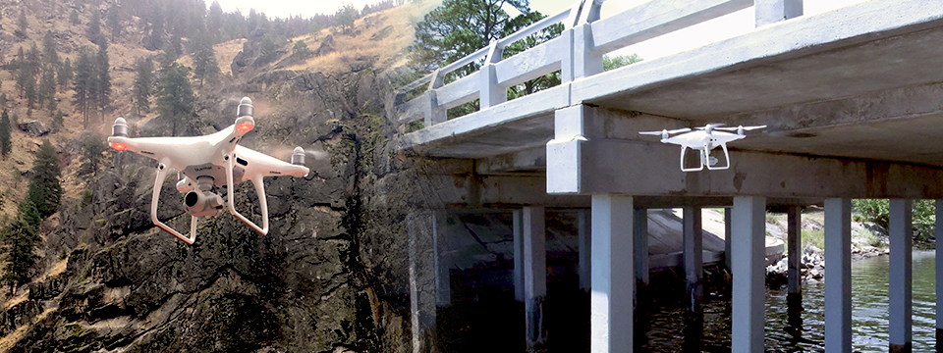
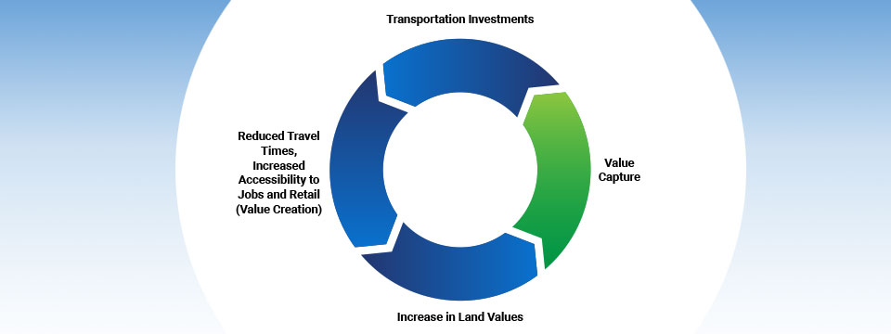
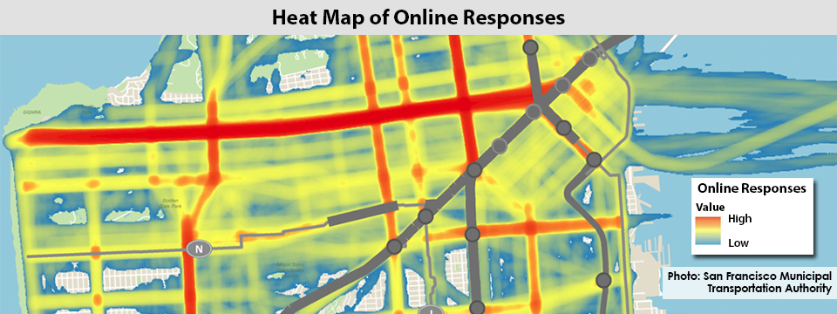
EDC 5 Innovations
Notes:
In order:
Automated Traffic Signal Performance Measures (ATSPMs)
Road Weather Management – Weather-Savvy Roads (Integrating Mobile Observations)
Data-Driven Safety Analysis (DDSA) (in Project Development)
e-Construction (not formal Partnering)
Using Data to Improve Traffic Incident Management
Pavement Preservation (When, Where) (How already Institutionalized)
Others that are institutionalized – Community Connections, Integrating NEPA and Permitting

Slide 19
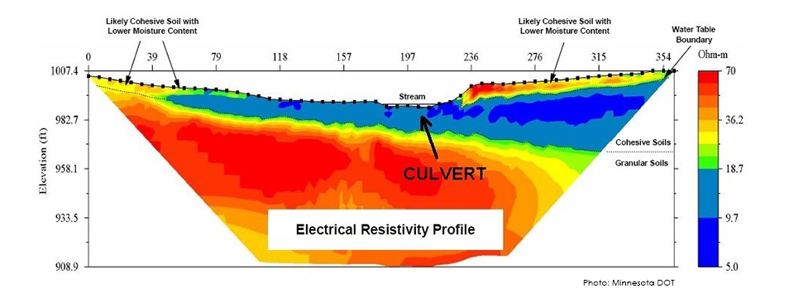
Advanced Geotechnical Exploration Methods
Improved solutions and nondestructive methods for generating the geotechnical profiles used for project design
Benefits
Reduced Risk
Improved Quality
Accelerated Project Delivery
Notes:
These changes and the challenges each pose require that the highway community look for better ways of doing business to stretch our transportation dollars and improve efficiency to deliver highway projects faster.
To keep pace with the changing times, we wanted to get innovations into practice that would: Shorten the project delivery process; Enhance safety; Reduce congestion; and Improve environmental sustainability.
Leadership in technology transfer and innovation deployment has been a fixture of the FHWA since its origination in 1893 as the Office of Road Inquiry.
Although the highway community has a long history of conducting research to find better solutions and processes, we also have a history of being slow to change and sticking with the way we have always done things.
To build on our legacy of technology transfer and create a sense of urgency, the FHWA launched the Every Day Counts (EDC) initiative in cooperation with AASHTO to do just that.
The name “Every Day Counts” was chosen to capture the driving public’s urgent need for transportation facilities delivered better, faster and smarter.

Slide 20
Collaborative Hydraulics: Advancing to the Next Generation of Engineering (CHANGE)
Next-generation hydraulic tools improve the understanding of complex interactions between river or coastal environments and transportation assets
Benefits
Improved Quality and Resiliency
Enhanced Collaboration
Streamlined Delivery
Notes:
These changes and the challenges each pose require that the highway community look for better ways of doing business to stretch our transportation dollars and improve efficiency to deliver highway projects faster.
To keep pace with the changing times, we wanted to get innovations into practice that would: Shorten the project delivery process; Enhance safety; Reduce congestion; and Improve environmental sustainability.
Leadership in technology transfer and innovation deployment has been a fixture of the FHWA since its origination in 1893 as the Office of Road Inquiry.
Although the highway community has a long history of conducting research to find better solutions and processes, we also have a history of being slow to change and sticking with the way we have always done things.
To build on our legacy of technology transfer and create a sense of urgency, the FHWA launched the Every Day Counts (EDC) initiative in cooperation with AASHTO to do just that.
The name “Every Day Counts” was chosen to capture the driving public’s urgent need for transportation facilities delivered better, faster and smarter.

Slide 21
Project Bundling
Awarding a single contract for several preservation, rehabilitation, or replacement projects
Benefits
Expedited Project Delivery
Reduced Cost
Efficiency
Notes:
These changes and the challenges each pose require that the highway community look for better ways of doing business to stretch our transportation dollars and improve efficiency to deliver highway projects faster.
To keep pace with the changing times, we wanted to get innovations into practice that would: Shorten the project delivery process; Enhance safety; Reduce congestion; and Improve environmental sustainability.
Leadership in technology transfer and innovation deployment has been a fixture of the FHWA since its origination in 1893 as the Office of Road Inquiry.
Although the highway community has a long history of conducting research to find better solutions and processes, we also have a history of being slow to change and sticking with the way we have always done things.
To build on our legacy of technology transfer and create a sense of urgency, the FHWA launched the Every Day Counts (EDC) initiative in cooperation with AASHTO to do just that.
The name “Every Day Counts” was chosen to capture the driving public’s urgent need for transportation facilities delivered better, faster and smarter.

Slide 22
Reducing Rural Roadway Departures
Systemic application of proven roadway departure countermeasures on rural roads can have a positive impact on safety and reduce serious injuries and fatalities
Benefits
Safer Roads
Quick Deployment
Flexibility
Notes:
These changes and the challenges each pose require that the highway community look for better ways of doing business to stretch our transportation dollars and improve efficiency to deliver highway projects faster.
To keep pace with the changing times, we wanted to get innovations into practice that would: Shorten the project delivery process; Enhance safety; Reduce congestion; and Improve environmental sustainability.
Leadership in technology transfer and innovation deployment has been a fixture of the FHWA since its origination in 1893 as the Office of Road Inquiry.
Although the highway community has a long history of conducting research to find better solutions and processes, we also have a history of being slow to change and sticking with the way we have always done things.
To build on our legacy of technology transfer and create a sense of urgency, the FHWA launched the Every Day Counts (EDC) initiative in cooperation with AASHTO to do just that.
The name “Every Day Counts” was chosen to capture the driving public’s urgent need for transportation facilities delivered better, faster and smarter.

Slide 23
Safe Transportation for Every Pedestrian (STEP)
Systemic application of cost-effective countermeasures with known safety benefits can help reduce pedestrian fatalities at both uncontrolled and signalized crossing locations
Benefits
Improved Safety
Targeted Investment
Enhanced Quality of Life
Notes:
These changes and the challenges each pose require that the highway community look for better ways of doing business to stretch our transportation dollars and improve efficiency to deliver highway projects faster.
To keep pace with the changing times, we wanted to get innovations into practice that would: Shorten the project delivery process; Enhance safety; Reduce congestion; and Improve environmental sustainability.
Leadership in technology transfer and innovation deployment has been a fixture of the FHWA since its origination in 1893 as the Office of Road Inquiry.
Although the highway community has a long history of conducting research to find better solutions and processes, we also have a history of being slow to change and sticking with the way we have always done things.
To build on our legacy of technology transfer and create a sense of urgency, the FHWA launched the Every Day Counts (EDC) initiative in cooperation with AASHTO to do just that.
The name “Every Day Counts” was chosen to capture the driving public’s urgent need for transportation facilities delivered better, faster and smarter.

Slide 24
Unmanned Aerial Systems (UAS)
UAS offer several transformative aspects for highway transportation, including improvements in safety, productivity, and cost
Benefits
Safety
Accelerated Project Delivery
Asset Management
Notes:
These changes and the challenges each pose require that the highway community look for better ways of doing business to stretch our transportation dollars and improve efficiency to deliver highway projects faster.
To keep pace with the changing times, we wanted to get innovations into practice that would: Shorten the project delivery process; Enhance safety; Reduce congestion; and Improve environmental sustainability.
Leadership in technology transfer and innovation deployment has been a fixture of the FHWA since its origination in 1893 as the Office of Road Inquiry.
Although the highway community has a long history of conducting research to find better solutions and processes, we also have a history of being slow to change and sticking with the way we have always done things.
To build on our legacy of technology transfer and create a sense of urgency, the FHWA launched the Every Day Counts (EDC) initiative in cooperation with AASHTO to do just that.
The name “Every Day Counts” was chosen to capture the driving public’s urgent need for transportation facilities delivered better, faster and smarter.

Slide 25
Use of Crowdsourcing to Advance Operations
Crowdsourcing allows transportation system users to be real-time sensors on system performance, providing low-cost, high-quality data on traffic operations, conditions, and patterns
Benefits
Safety
Accelerated Project Development
Asset Management
Notes:
These changes and the challenges each pose require that the highway community look for better ways of doing business to stretch our transportation dollars and improve efficiency to deliver highway projects faster.
To keep pace with the changing times, we wanted to get innovations into practice that would: Shorten the project delivery process; Enhance safety; Reduce congestion; and Improve environmental sustainability.
Leadership in technology transfer and innovation deployment has been a fixture of the FHWA since its origination in 1893 as the Office of Road Inquiry.
Although the highway community has a long history of conducting research to find better solutions and processes, we also have a history of being slow to change and sticking with the way we have always done things.
To build on our legacy of technology transfer and create a sense of urgency, the FHWA launched the Every Day Counts (EDC) initiative in cooperation with AASHTO to do just that.
The name “Every Day Counts” was chosen to capture the driving public’s urgent need for transportation facilities delivered better, faster and smarter.

Slide 26
Value Capture: Capitalizing on the Value Created by Transportation
Strategies for agencies to recover a portion of public transportation investments that result in increased land values
Benefits
Continuous Improvement
Financial Equity
Environmental Resiliency
Notes:
These changes and the challenges each pose require that the highway community look for better ways of doing business to stretch our transportation dollars and improve efficiency to deliver highway projects faster.
To keep pace with the changing times, we wanted to get innovations into practice that would: Shorten the project delivery process; Enhance safety; Reduce congestion; and Improve environmental sustainability.
Leadership in technology transfer and innovation deployment has been a fixture of the FHWA since its origination in 1893 as the Office of Road Inquiry.
Although the highway community has a long history of conducting research to find better solutions and processes, we also have a history of being slow to change and sticking with the way we have always done things.
To build on our legacy of technology transfer and create a sense of urgency, the FHWA launched the Every Day Counts (EDC) initiative in cooperation with AASHTO to do just that.
The name “Every Day Counts” was chosen to capture the driving public’s urgent need for transportation facilities delivered better, faster and smarter.

Slide 27
Virtual Public Involvement
Virtual public involvement supports agencies efforts to engage the public more effectively by supplementing face-to-face information sharing with technology
Benefits
Efficiency and Low Cost
Accelerated Project Delivery
Expands Communication and Collaboration
Notes:
These changes and the challenges each pose require that the highway community look for better ways of doing business to stretch our transportation dollars and improve efficiency to deliver highway projects faster.
To keep pace with the changing times, we wanted to get innovations into practice that would: Shorten the project delivery process; Enhance safety; Reduce congestion; and Improve environmental sustainability.
Leadership in technology transfer and innovation deployment has been a fixture of the FHWA since its origination in 1893 as the Office of Road Inquiry.
Although the highway community has a long history of conducting research to find better solutions and processes, we also have a history of being slow to change and sticking with the way we have always done things.
To build on our legacy of technology transfer and create a sense of urgency, the FHWA launched the Every Day Counts (EDC) initiative in cooperation with AASHTO to do just that.
The name “Every Day Counts” was chosen to capture the driving public’s urgent need for transportation facilities delivered better, faster and smarter.

Slide 28
Weather-Responsive Management Strategies
Strategies that increase the effectiveness of traffic operations during adverse road weather conditions, and weather-responsive maintenance management strategies help reduce costs associated with winter maintenance
Benefits
Safer Roads
Informed Travelers
Environmental Sustainability
Notes:
These changes and the challenges each pose require that the highway community look for better ways of doing business to stretch our transportation dollars and improve efficiency to deliver highway projects faster.
To keep pace with the changing times, we wanted to get innovations into practice that would: Shorten the project delivery process; Enhance safety; Reduce congestion; and Improve environmental sustainability.
Leadership in technology transfer and innovation deployment has been a fixture of the FHWA since its origination in 1893 as the Office of Road Inquiry.
Although the highway community has a long history of conducting research to find better solutions and processes, we also have a history of being slow to change and sticking with the way we have always done things.
To build on our legacy of technology transfer and create a sense of urgency, the FHWA launched the Every Day Counts (EDC) initiative in cooperation with AASHTO to do just that.
The name “Every Day Counts” was chosen to capture the driving public’s urgent need for transportation facilities delivered better, faster and smarter.

Slide 29
Questions?
Jason J. Siwula, PE
Acting Executive Director – Office of Highway Safety
Assistant State Highway Engineer - Innovation
Kentucky Transportation Cabinet
Jason.Siwula@ky.gov

